Slide 1
AWS Networking Services
Bachelor of Engineering - Computer Science & Engineering
Cloud Computing (CC)(23CS009)
Department of Computer Science & Engineering
Chitkara University Institute of Engineering and Technology, Chitkara University, Punjab, India

Slide 2
Contents
AWS Networking Services
Virtual Private Network (VPN)
Virtual Private Cloud (VPC)
VPN vs. VPC

Slide 3
AWS Networking Services
Amazon Web Services (AWS) provides a comprehensive suite of networking services that enable businesses to build secure, scalable, and high-performing cloud infrastructures.
These services facilitate seamless communication between resources, secure data transfers, and the efficient delivery of applications across the globe.
Some key AWS networking services and their functionalities are:

Slide 4
AWS Networking Services
1. Amazon Virtual Private Cloud (VPC)
Amazon VPC allows users to create isolated virtual networks within the AWS cloud. It provides complete control over IP address ranges, subnets, route tables, and network gateways. Users can securely connect their on-premises infrastructure to the cloud using AWS Direct Connect or VPN.
Key Features:
● Subnet segmentation (public and private subnets)
● Security through Network Access Control Lists (NACLs) and Security Groups
● Internet Gateway (IGW) for external communication
● Virtual Private Gateway (VGW) for private connections

Slide 5
AWS Networking Services
Examples of Amazon VPC Usage:
■ Netflix: Uses AWS VPC to handle massive streaming traffic securely.
■ Airbnb: Manages user data in a secure cloud environment using VPC.
■ FINRA (Financial Industry Regulatory Authority): Ensures compliance and secure transaction processing using AWS VPC.

Slide 6
AWS Networking Services
2. AWS Direct Connect
AWS Direct Connect is a dedicated network service that provides private, low-latency, and high-bandwidth connections between on-premises data centers and AWS resources. This service is ideal for organizations with heavy data workloads or regulatory requirements for private connections.
Key Features:
● Enhanced performance with consistent bandwidth
● Lower data transfer costs
● Secure and private connectivity

Slide 7
AWS Networking Services
3. Elastic Load Balancing (ELB)
Elastic Load Balancing distributes incoming application traffic across multiple targets (e.g., EC2 instances, containers) to ensure availability and fault tolerance. AWS provides three types of load balancers:
● Application Load Balancer (ALB) – Operates at the application layer (Layer 7), ideal for HTTP/HTTPS traffic.
● Network Load Balancer (NLB) – Works at the transport layer (Layer 4), designed for TCP/UDP traffic with ultra-low latency.
● Gateway Load Balancer (GWLB) – Manages and routes traffic to third-party virtual appliances.

Slide 8
AWS Networking Services
4. Amazon Route 53
Amazon Route 53 is a scalable Domain Name System (DNS) web service that connects user requests to AWS resources. It offers domain registration, DNS routing, and health-checking capabilities.
Key Features:
● Global DNS management with low-latency routing
● Traffic flow policies (e.g., weighted, latency-based, geolocation)
● Domain registration and DNS failover

Slide 9
AWS Networking Services
5. AWS Transit Gateway
AWS Transit Gateway simplifies the management of large-scale networks by allowing users to connect multiple VPCs, on-premises networks, and remote locations through a single gateway.
Key Features:
● Centralized network management
● Scalable inter-VPC connectivity
● Integration with AWS Direct Connect and VPN

Slide 10
AWS Networking Services
6. AWS Global Accelerator
AWS Global Accelerator enhances the performance and availability of global applications by routing traffic through the AWS global network.
Key Features:
● Reduced latency with optimal routing
● Automatic failover across AWS Regions
● Support for both TCP and UDP traffic

Slide 11
AWS Networking Services
7. AWS Private Link
AWS Private Link enables secure access to AWS services and third-party applications over a private network, avoiding public internet exposure.
Key Features:
● Secure and private connectivity
● Reduced data exposure risks
● Simplified network architecture

Slide 12
AWS Networking Services
8. AWS CloudFront
AWS CloudFront is a fast, global Content Delivery Network (CDN) service that securely delivers data, videos, applications, and APIs to users with low latency.
Key Features:
● Edge locations for faster delivery
● Integration with AWS Shield for DDoS protection
● Support for real-time streaming

Slide 13
VPN and VPC
In modern cloud computing and networking,
VPN (Virtual Private Network) and
VPC (Virtual Private Cloud) play critical roles in securing and managing network resources.
While both technologies offer privacy and isolation, they serve distinct purposes and operate differently within a network infrastructure.

Slide 14
Virtual Private Network (VPN)
A VPN is a technology that creates a secure, encrypted connection between a user's device or private network and a remote network over the public internet.
It allows users to access private resources securely while maintaining confidentiality and data integrity.
● How VPN Works
When a user connects to a VPN, their internet traffic is encrypted and routed through a secure tunnel to a VPN server.
This process masks the user’s IP address and protects the data from being intercepted by malicious actors.

Slide 15
Virtual Private Network (VPN)
● Types of VPNs
1. Site-to-Site VPN: Connects entire networks (e.g., branch offices to a corporate headquarters).
2. Remote Access VPN: Allows individual users to access a private network securely from remote locations.
● Benefits of VPN
○ Secure data transmission through encryption.
○ Remote access to private networks.
○ Protection against cyber threats and data interception.
○ Anonymity by hiding the user's IP address.

Slide 16
Virtual Private Cloud (VPC)
A VPC is a logically isolated section of a public cloud (such as AWS, Azure, or Google Cloud) where users can deploy and manage virtual resources like servers, databases, and storage.
It allows for full control over the networking environment, including IP addressing, subnets, and route tables.
● How VPC Works
Within a VPC, users can divide resources into subnets (public or private) and establish network gateways to control inbound and outbound traffic.
This isolation ensures that cloud resources remain secure and independent from other tenants on the cloud.

Slide 17
Virtual Private Cloud (VPC)
● Key Components of a VPC:
1. Subnets: Divisions within the VPC for organizing resources.
2. Route Tables: Define how traffic flows between subnets and external networks.
3. Security Groups and NACLs: Control access through firewall-like rules.
4. Internet Gateway (IGW): Allows public access to resources in the VPC.
● Benefits of VPC:
○ Isolated and secure cloud environment.
○ Customizable IP address ranges and subnets.
○ Scalable and flexible architecture.
○ Controlled access with security policies.

Slide 18
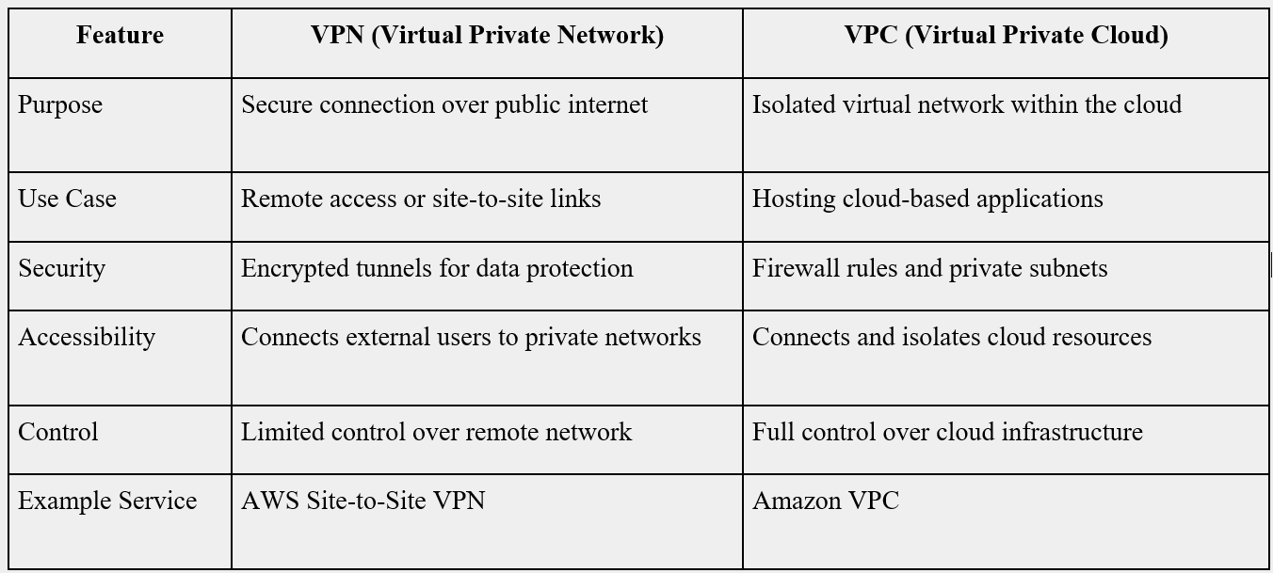
VPN vs. VPC

Slide 19
Summary
AWS Networking Services
Virtual Private Network (VPN)
Virtual Private Cloud (VPC)
VPN vs. VPC

Slide 20
References
Recommended Books:
B01: Architecting the Cloud: Design Decisions for Cloud Computing Service Models by Michael J. Kavis, 2014.
BO2: AWS The Ultimate Guide to Amazon Web Services Step-by-step Guide from Beginners to Advanced! by Stephen Springwell, Amplitude Ltd., Feb-2021.
BO3: Learning Amazon Web Services (AWS): A Hands-On Guide to the Fundamentals of AWS Cloud, First Edition by Pearson (Mark Wilkins), Nov-2019.
Link for Online Resource:
https://www.coursera.org/specializations/cloud-computing
https://aws.amazon.com/training/
https://onlinecourses.nptel.ac.in/noc21_cs14/preview
https://www.udemy.com/course/introduction-to-cloud-computing-on-amazon-aws-for-beginners/

Slide 21
THANK YOU
Cloud Computing

